Slide 1


Feedback for psychotherapists in Cognitive Behavioral Therapy

Slide 2

A therapy session is recorded

Slide 3


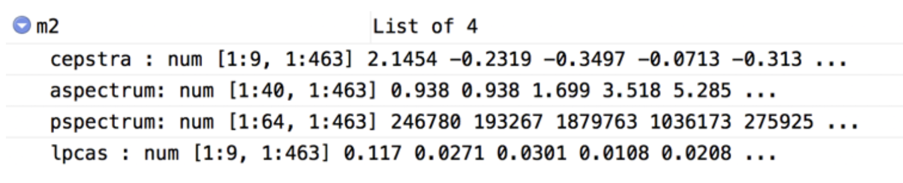
0:00 / 0:30
The recording is transformed into data that may be analysed using computer software
Features of the speech data (e.g., pitch, voice monotomy) are anaysed to generate a feedback report for the therapist
Feedback report

Slide 4
Feedback report
Therapist
M. Peter
Client
A. Miller
Global ratings
advanced: 4.0
Session strengths
Excellent use of reflections.
3.60
basic: 3.5
3.49
Areas for improvement
You could ask more open questions.
The recommendations are based on comparing the content of the recorded session to an optimally working treatment session
Overall competence
Empathy
Behavior counts
Reflection to question ratio: 92
Percent open questions: 48
Notes:
Add information about training dataset (how were recommendations derived?)
- the recommentation (e.g., level of empathy) were derived by comparing the recordings to therapy sessions that were identified as optimal

Slide 5

The feedback may be used for training and skill improvement

